Slide 1

William Roberts CIS216 Prof. Stephen Leggett Task 11

Slide 2
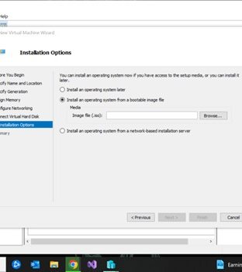
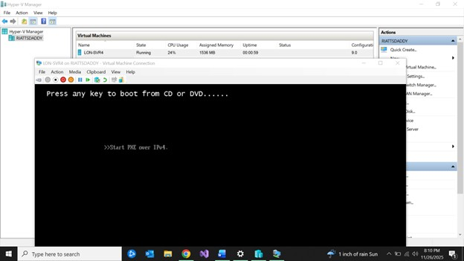
Create LON-SR4 on HyperV

Slide 3
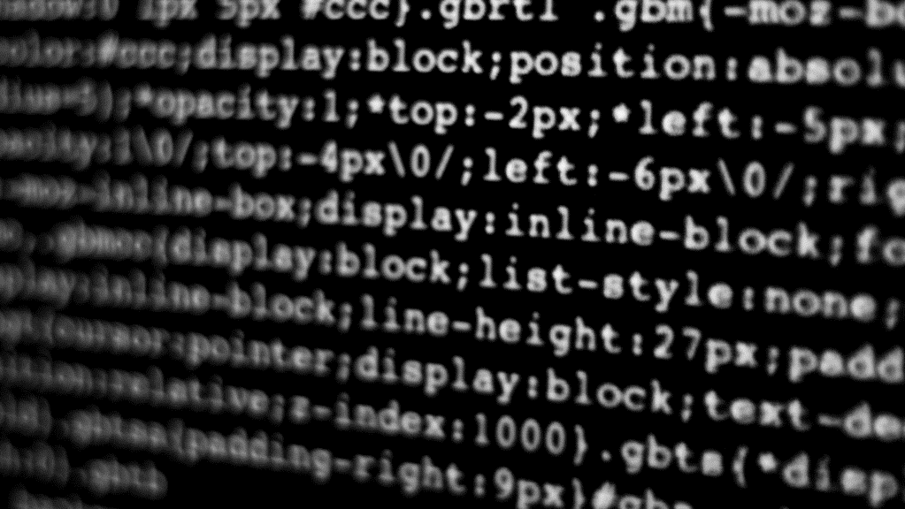
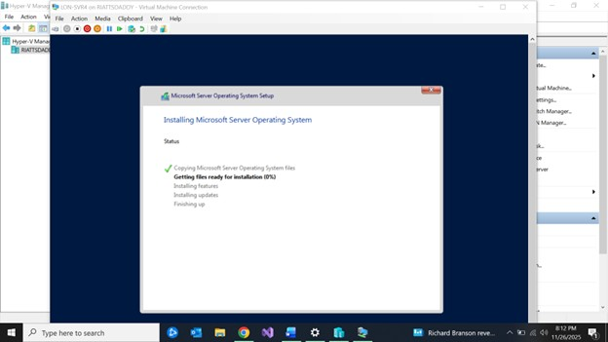
Start Lon-SVR4

Slide 4
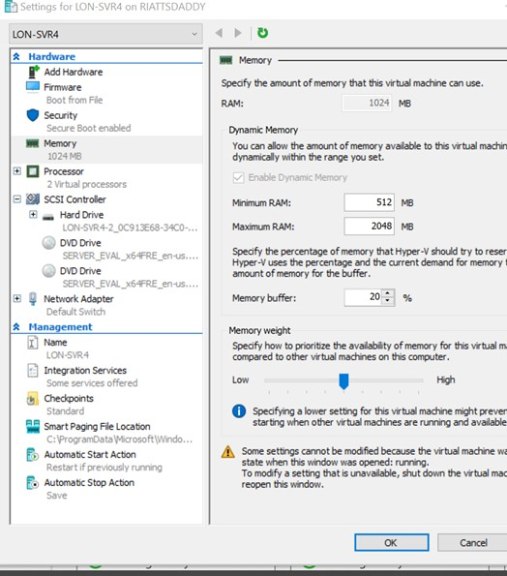
Hyper-V Memory
Here RAM was adjusted to meet the requirements of the host machine.

Slide 5
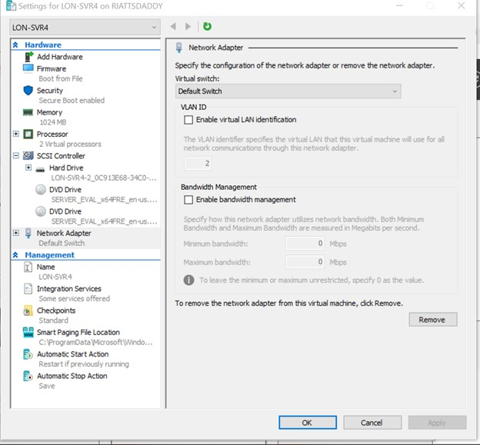
Network adapter set
I set the network adapter to be able to use the network from the host machine to connect to the other devices and the internet on the network.

Slide 6
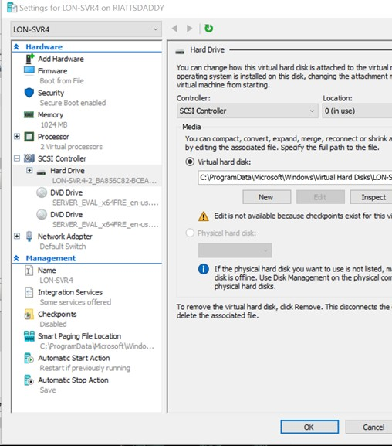
Connect a Virtual Hard Disk
Here is the image showing VHD attached

Slide 7
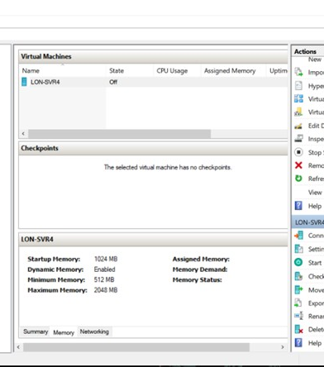
Manage Smart Paging & Check Memory Status
Here you can see the memory set up and that it is se to Dynamic Memory.

Slide 8
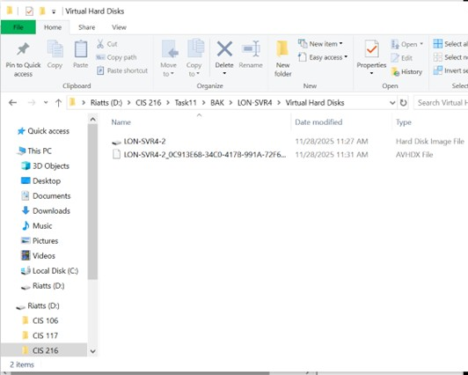
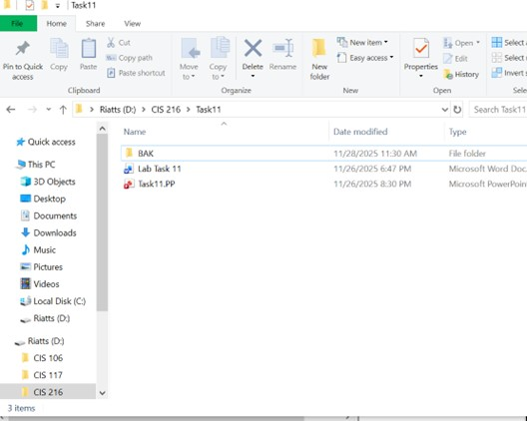
Export the VM Here you can see the VM in my files

Slide 9
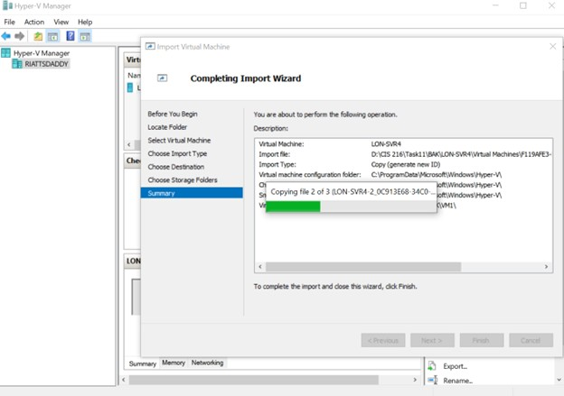
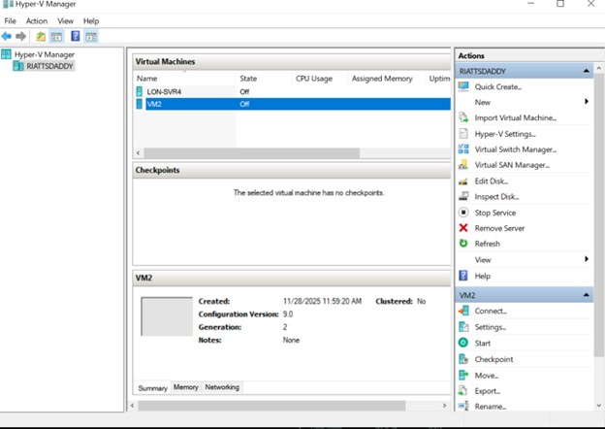
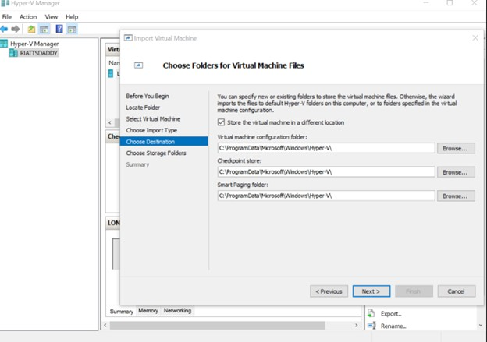
Import the VM Here I imported the VM and named it VM2

Slide 10
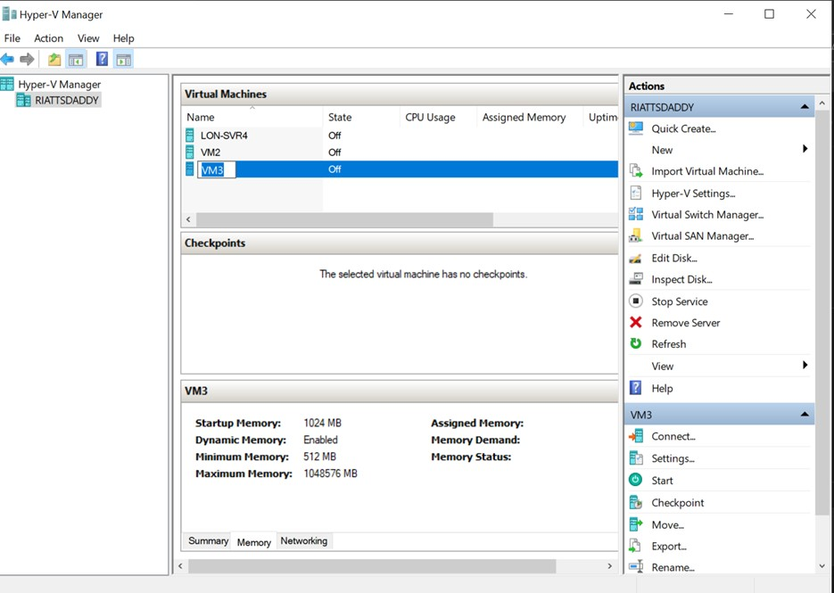
Create VM3

Slide 11
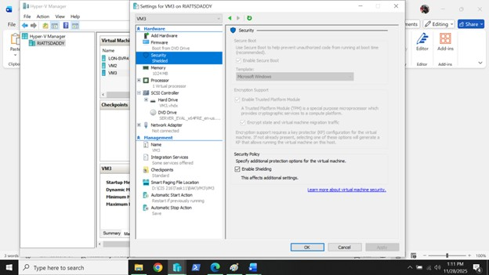
Implementing Hyper-V Security Options
Here in VM3 changed security settings to enable TPM, Encrypt stat and virtual machine traffic and Enable Shielding.

